Slide 1
AI Unpacked: Large Language Models
Podcast Presentation | Segment 1 & 2

Slide 2
Segment 1: What Are LLMs?
LLMs are advanced deep learning models based on Transformer architectures.
They process sequences and understand long-range dependencies in language.
Foundation Models are trained on vast, diverse datasets, enabling broad adaptability.
They support many business functions: content generation, code analysis, multilingual tasks, and Q&A.
LLM deployments require:
1. A parameter file (weights = knowledge)
2. A codebase (model architecture & inference logic)
Together, they form the operational engine behind AI applications.

Slide 3
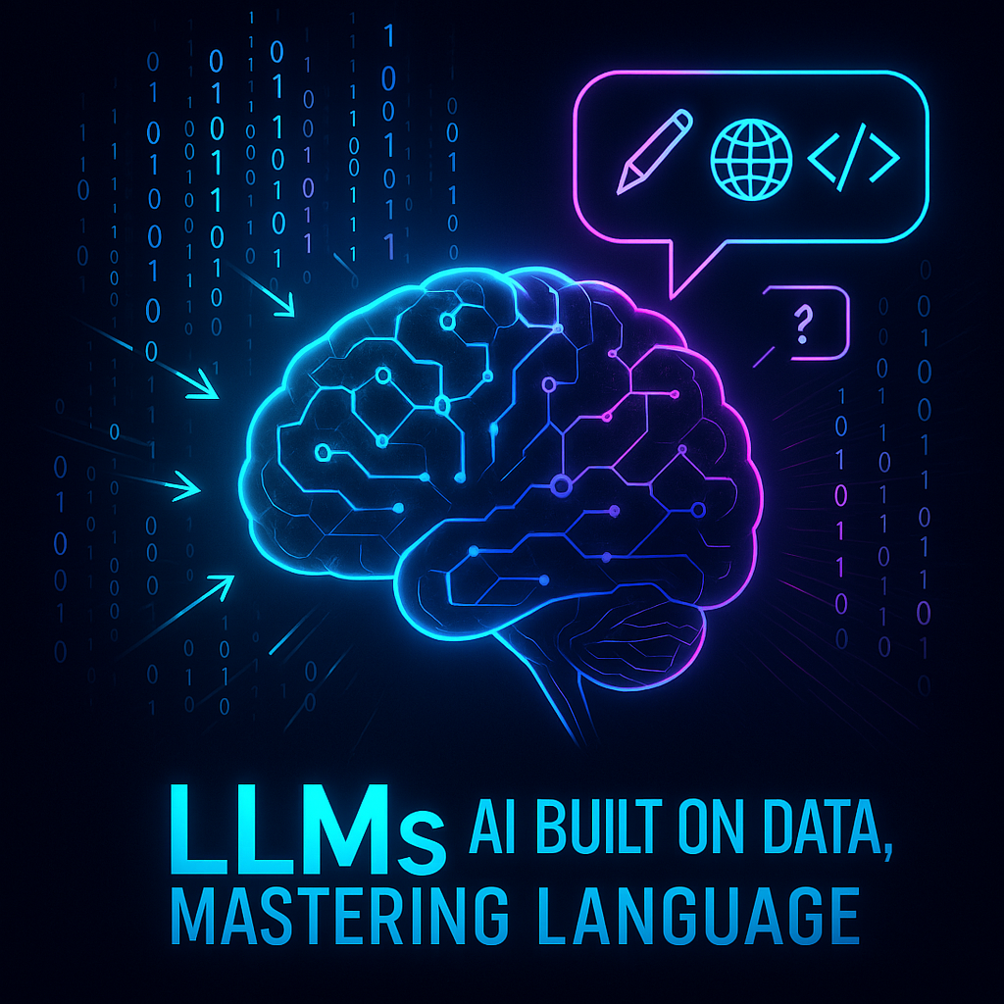
Core LLM Concept

Slide 4
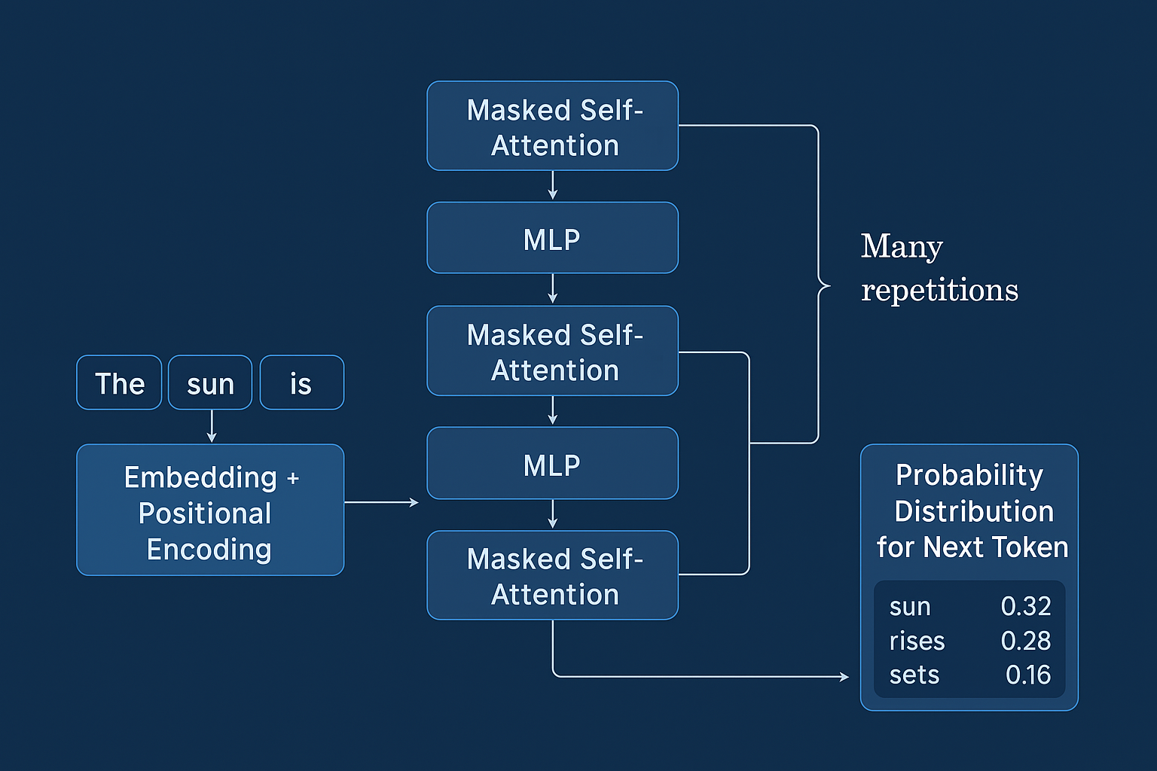
Transformer Architecture

Slide 5
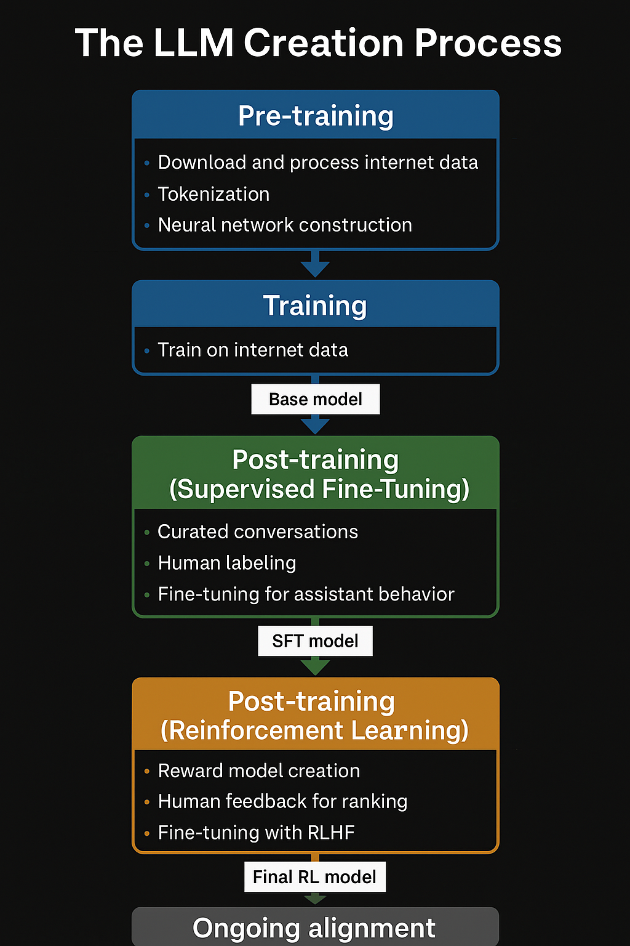
LLM Creation Pipeline Phases:
Pre-training
Supervised Fine-Tuning (SFT)
Reinforcement Learning (RLHF)
Inference
Ongoing Alignment

Slide 6
Segment 2 - Step 1: Data Collection
Raw data comes from Common Crawl (web pages), books, code, articles.
Visual pipeline shows:
- URL & language filtering
- Text extraction
- PII removal
- Deduplication
Results in a dataset like FineWeb (15T tokens, 44TB).
Goal: High-quality, diverse text data for general language understanding.

Slide 7
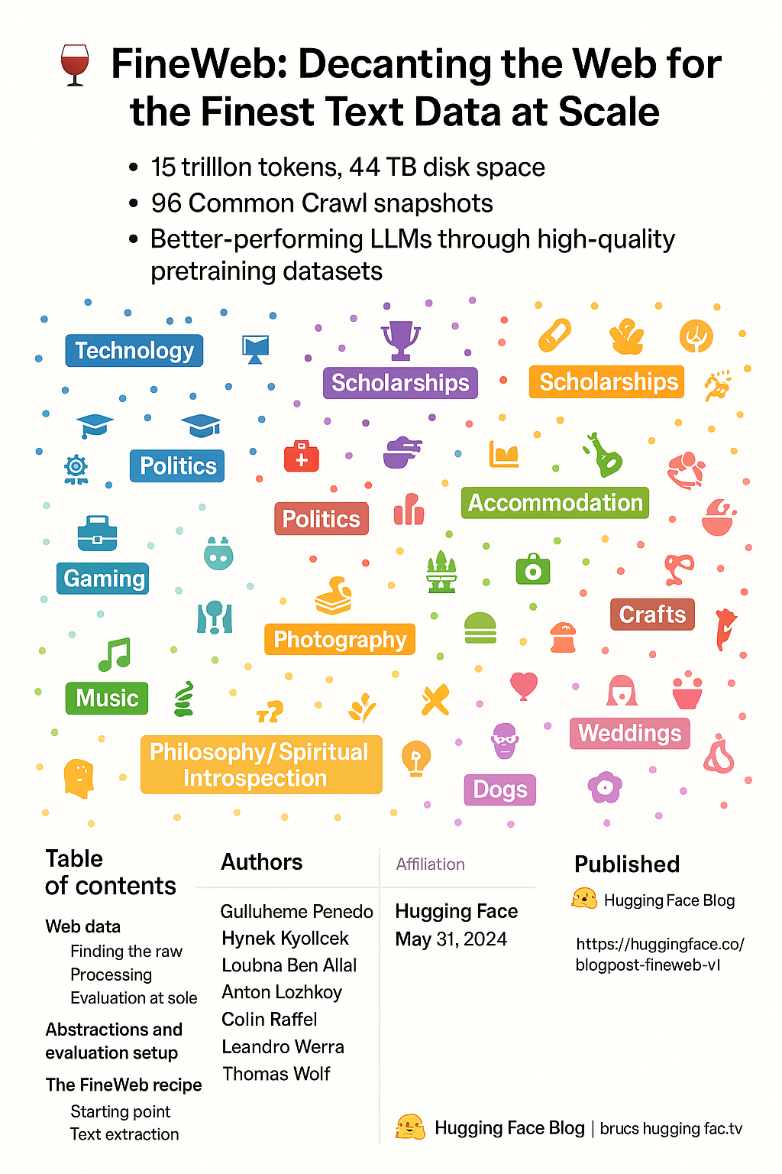
FineWeb Recipe

Slide 8
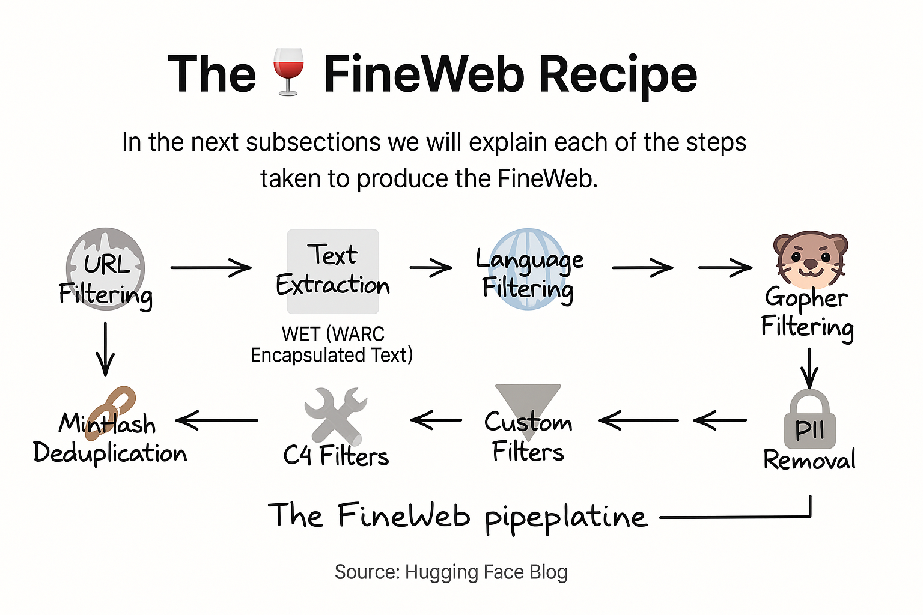
Data Cleaning Steps

Slide 9
Segment 2 - Step 2: Tokenization
Text is converted into tokens (words/subwords) using methods like Byte-Pair Encoding (BPE).
Why subwords?
- Handles rare words
- Reduces vocabulary size (~100K tokens)
Each token maps to a unique ID.
Tokenizer transforms input text to a sequence of IDs – model-readable format.

Slide 10
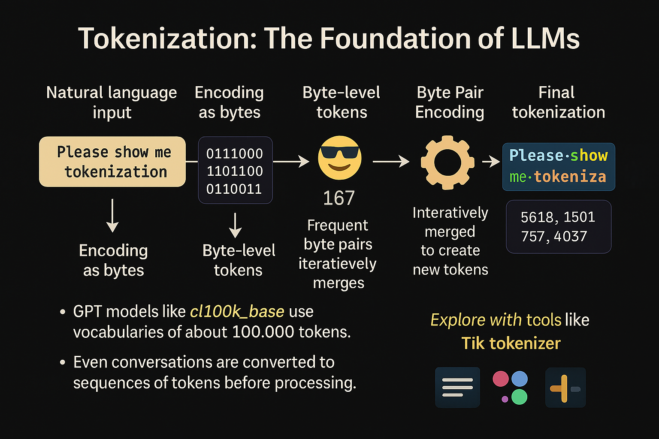
Tokenization Process

Slide 11
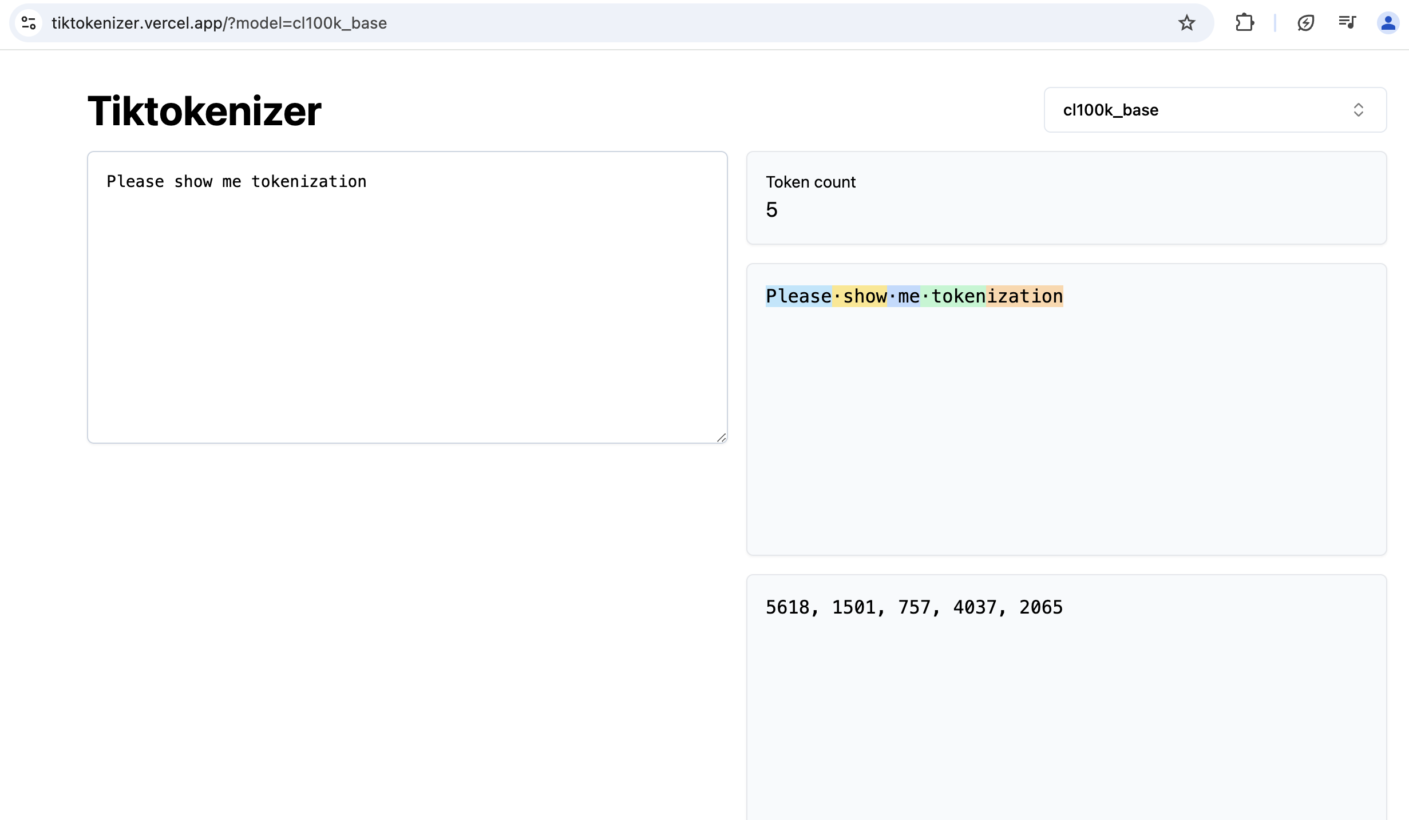
Tiktokenizer Output

Slide 12
Embeddings
Token IDs are mapped to dense vectors – embeddings.
Embeddings are stored in a large matrix (one vector per token).
Embeddings form the first layer of the model and encode semantic meaning.
Vectors are learned during training and capture semantic similarity.
Examples:
- king - man + woman ≈ queen
- sushi + Germany - Japan ≈ bratwurst
Embeddings evolve with training and support deeper context understanding.

Slide 13
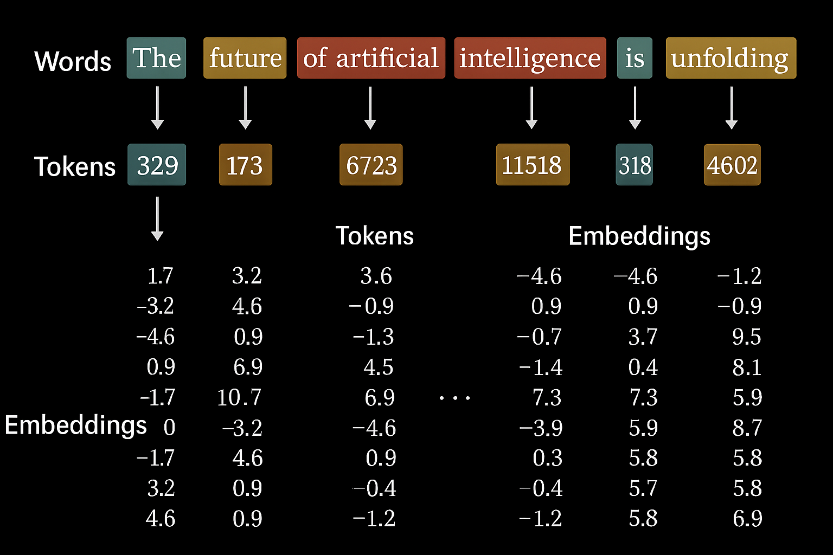
Embedding Table

Slide 14
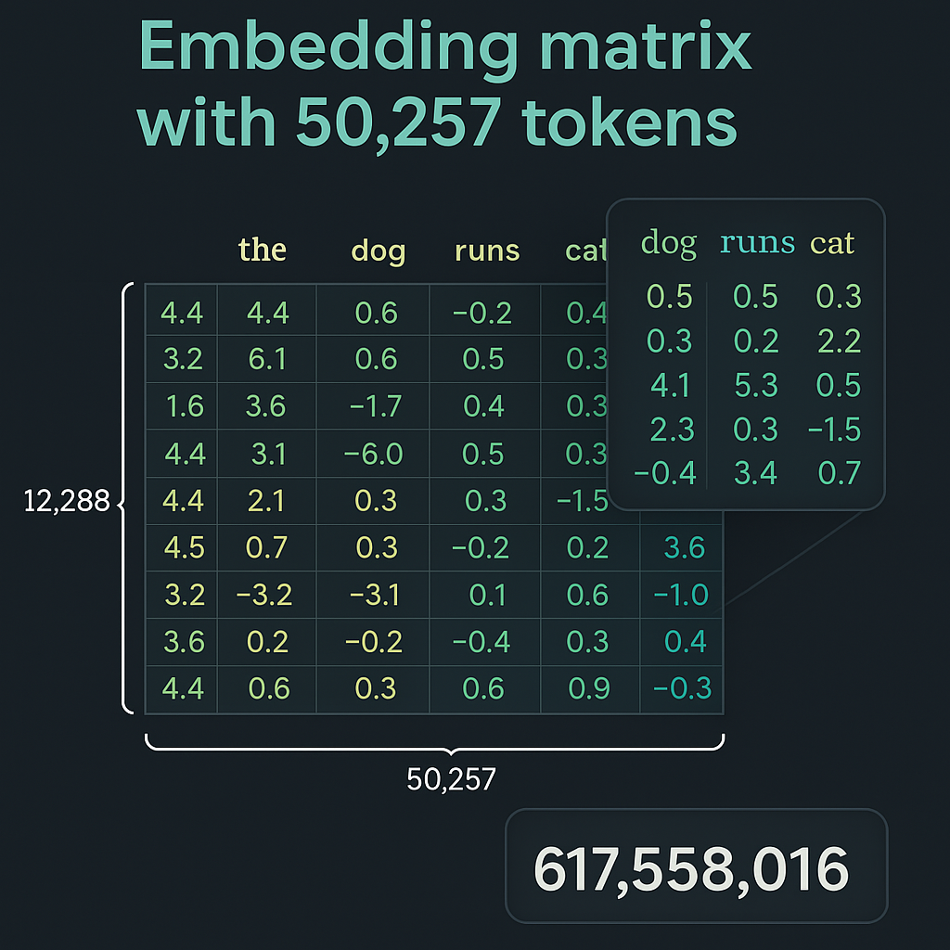
Embedding Matrix

Slide 15
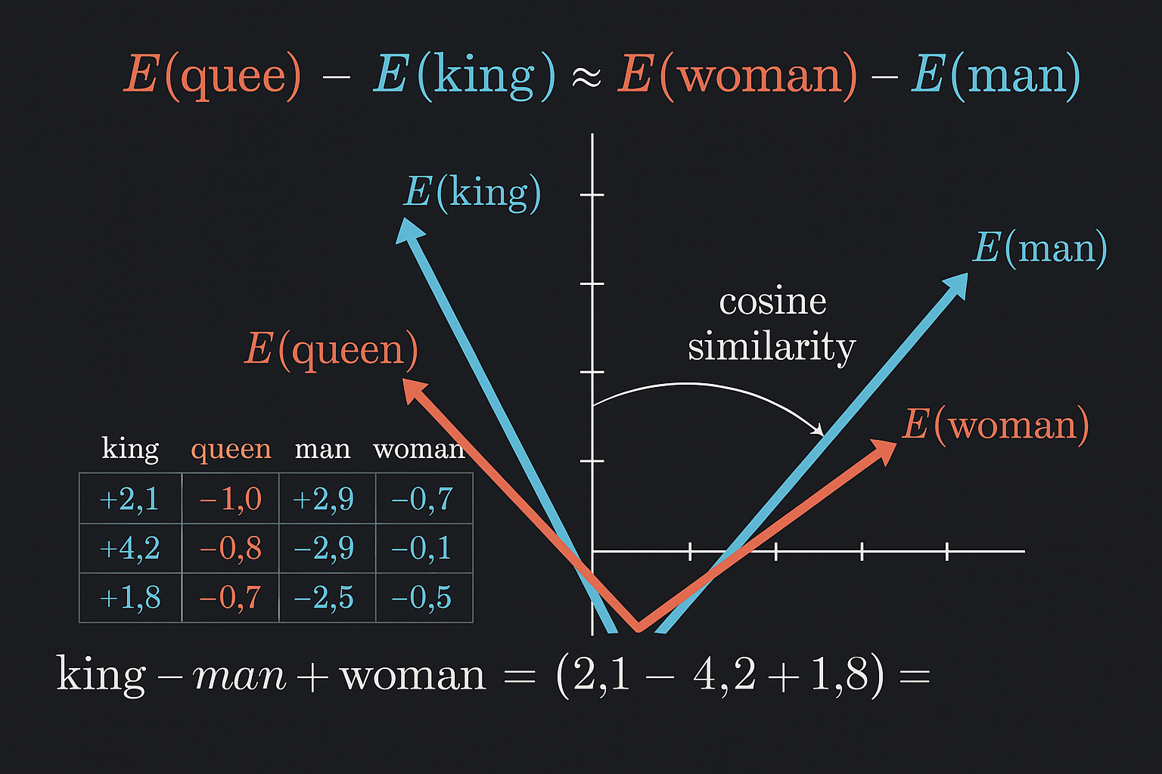
Embedding Analogy: King-Queen

Slide 16
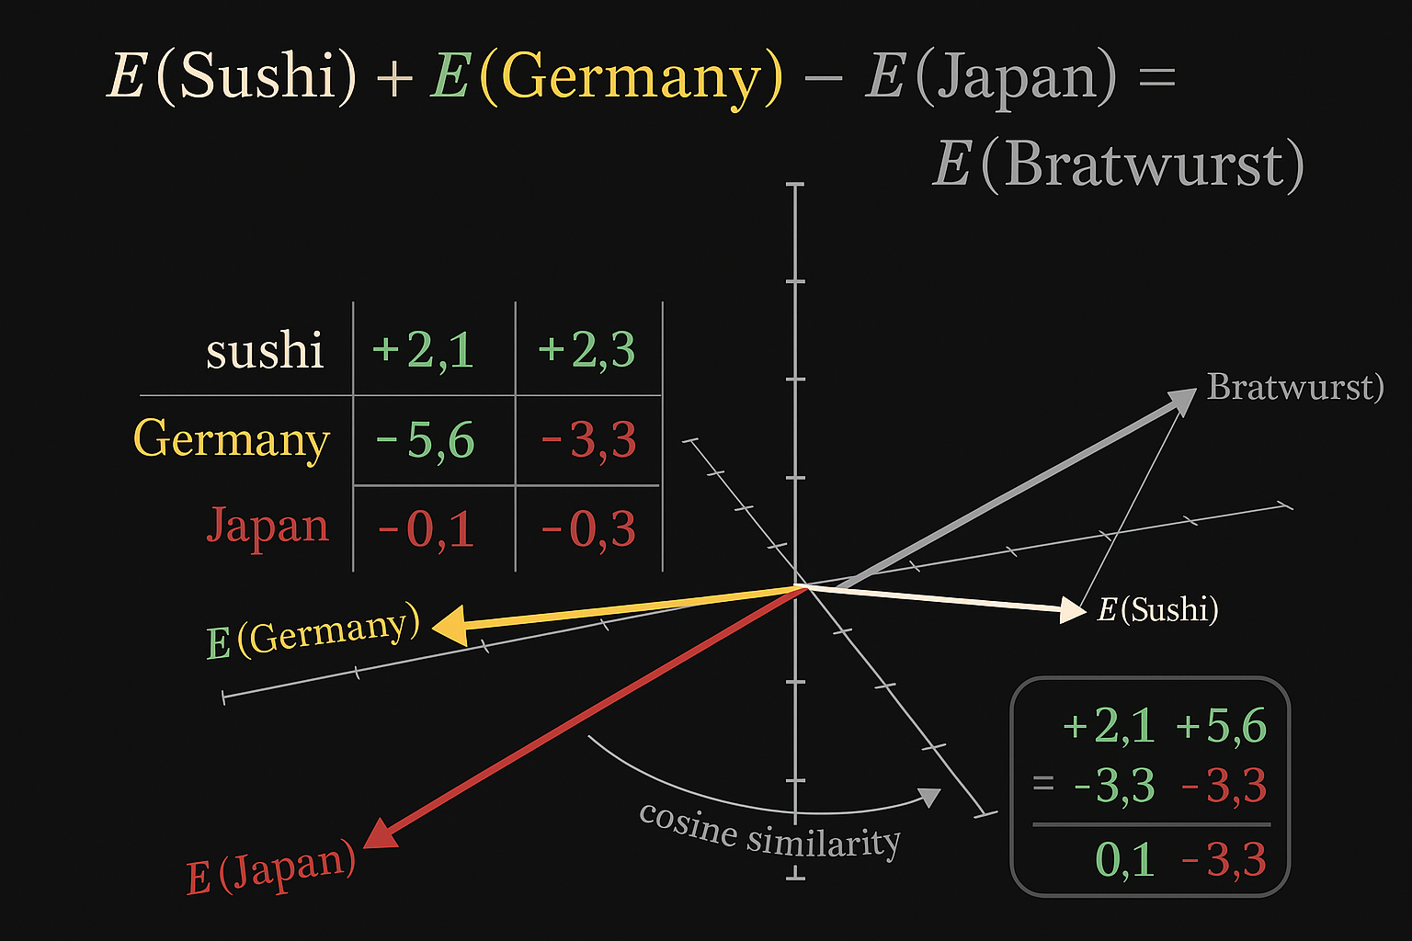
Embedding Analogy: Sushi-Bratwurst

Slide 17
Segment 2 - Step 4: Base Model Training
Goal: Predict the next token in a sequence based on context.
Process:
- Embeddings go through layers of the Transformer
- Output is a probability distribution over next-token candidates
Training uses a sliding context window (e.g., 2K–128K tokens).
Each step adjusts weights using gradient descent.
End result: A Base Model, capable of realistic text generation but not yet aligned or instructed.

Slide 18
Base Model Training
Objective: Predict the next token based on massive internet-scale datasets.
Produces the Base Model (highly knowledgeable, not yet an assistant).

Slide 19
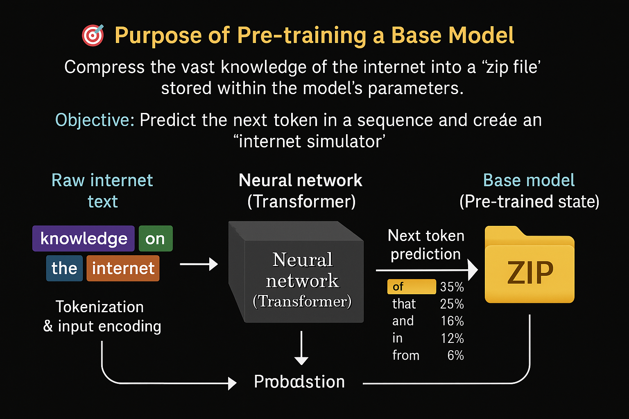
Purpose of Pre-Training

Slide 20
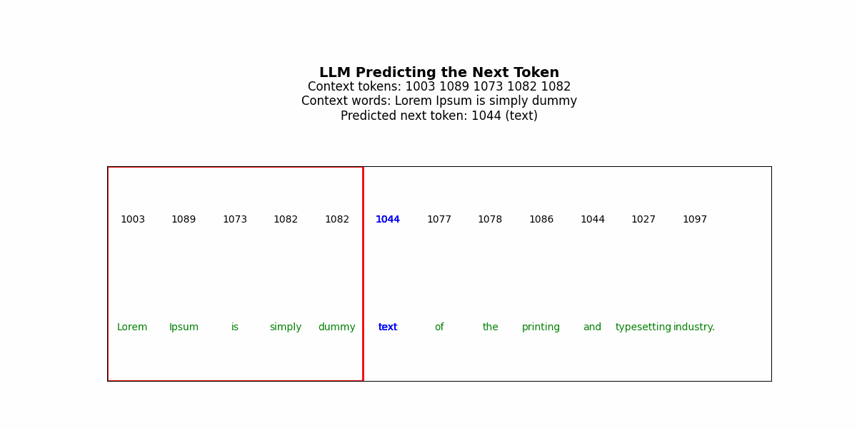
Context Window & Token Prediction

Slide 21
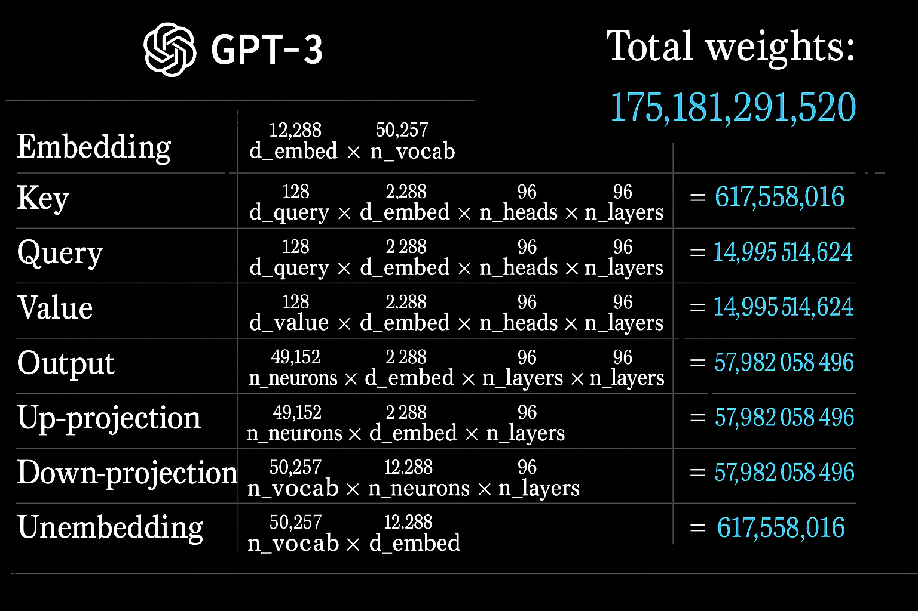
GPT-3 Parameters

Slide 22
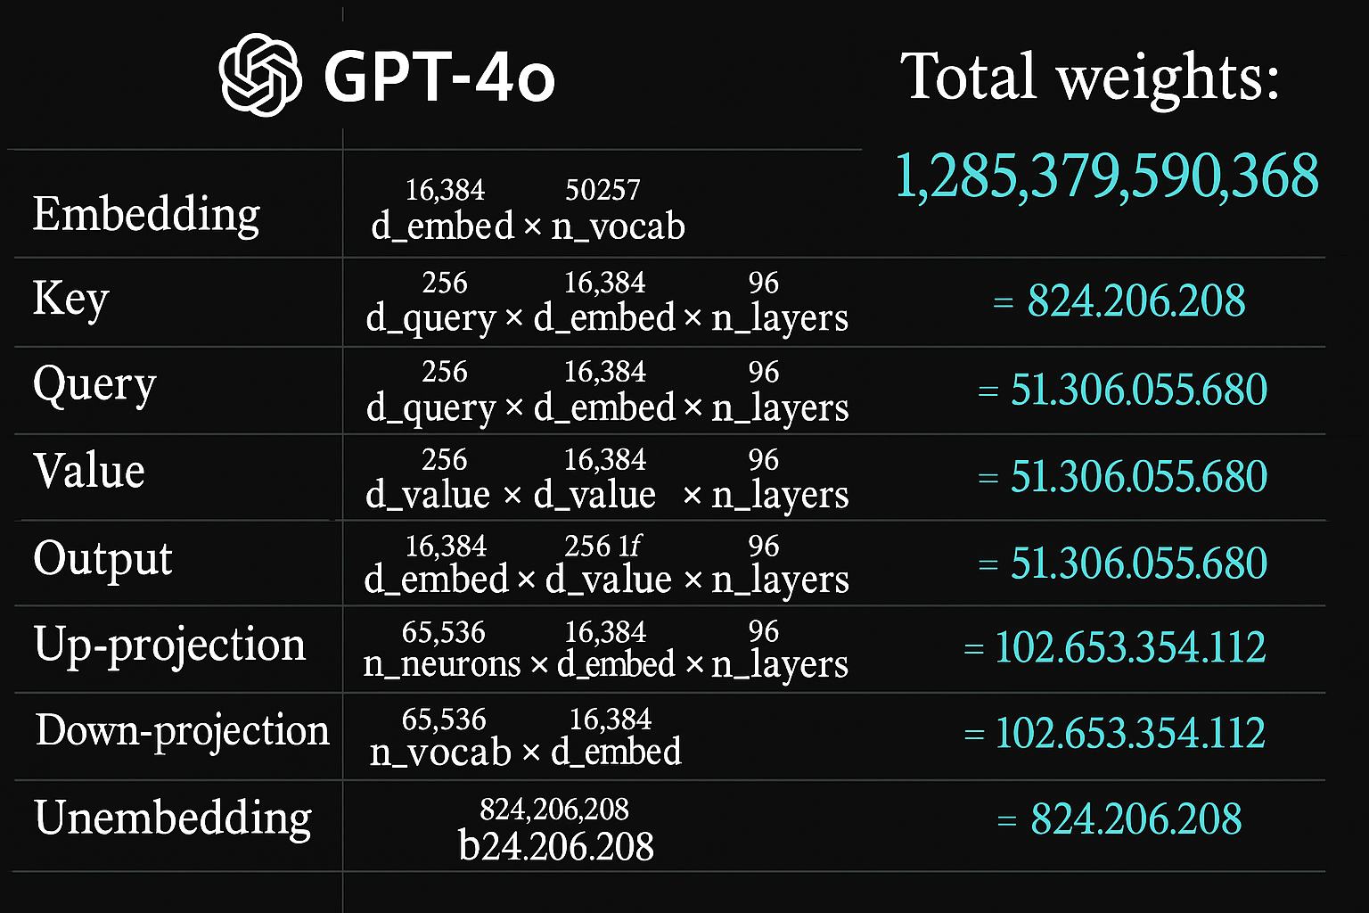
GPT-4o Parameters

Slide 23
Supervised Fine-Tuning (SFT)
Uses curated user prompts and human-labeled responses.
Trains the model to follow instructions and adopt helpful, harmless, truthful behavior.

Slide 24
SFT - Data Structure & Guidelines
Prompt-response pairs encoded with special tokens (e.g., <|im_start|> user <|im_sep|> response).
Labeling instructions define tone, format, ethics.

Slide 25
RLHF
Beyond imitation: optimizing for goals using rewards and human preferences.
Allows models to refine tone, format, safety.

Slide 26
LLMs in 2025: Scale, Cost, and Global Stakes
Understanding the competitive and geopolitical dynamics of modern AI development

Slide 27
Backdoors and Hidden Triggers: The Threat of Undetected Misalignment

Slide 28
Jailbreaking vs. Emergent Misalignment

Slide 29
Emergent Misalignment: Broader Behavior from Narrow Training

Slide 30
Training Costs and Token Counts for LLMs (March 2025)

